Slide 1
NF Progress Update: Pure L/H fitting and L-H mixture preliminary results
Full collaboration group meeting
02/01/2023

Slide 2
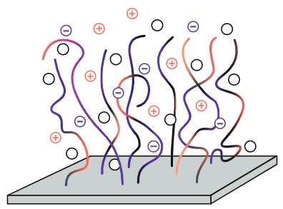



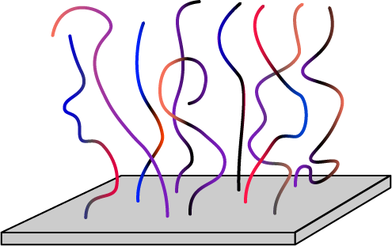


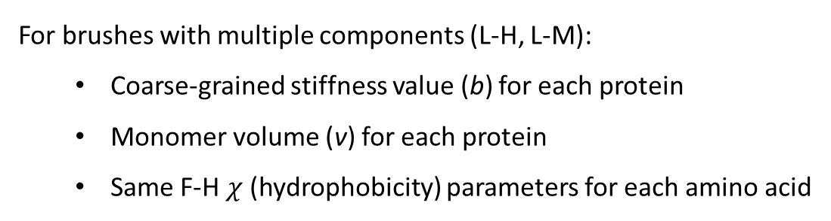

Model Overview
Interactions:
Flory-Huggins (2-body) between solvent and monomers
Elasticity between monomers of the same chain
Electrostatics between all (charged) monomers and ions
(
)
(
)
Model protein brush
For brushes with multiple components (L-H, L-M):
Coarse-grained stiffness value (b) for each protein
Monomer volume (v) for each protein
Same F-H $χ$ (hydrophobicity) parameters for each amino acid
Binary protein brush
$σ$(Total) = $σ$ ( ) + $σ$ ( )

Slide 3
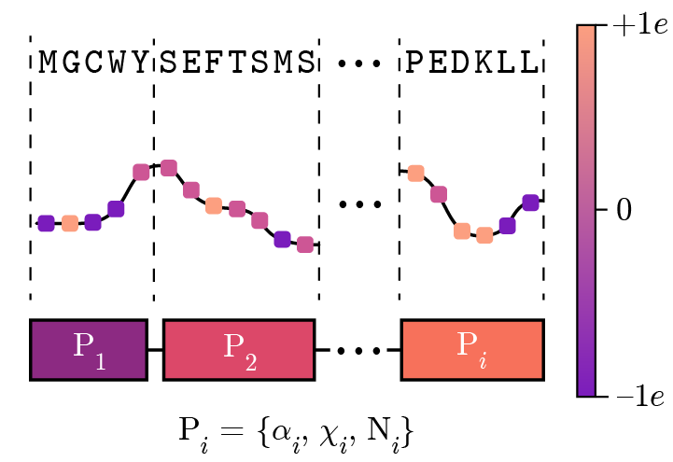
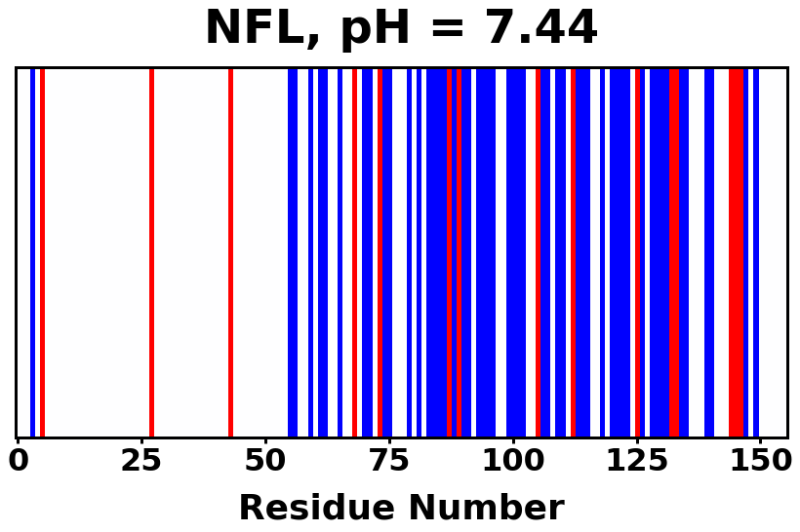

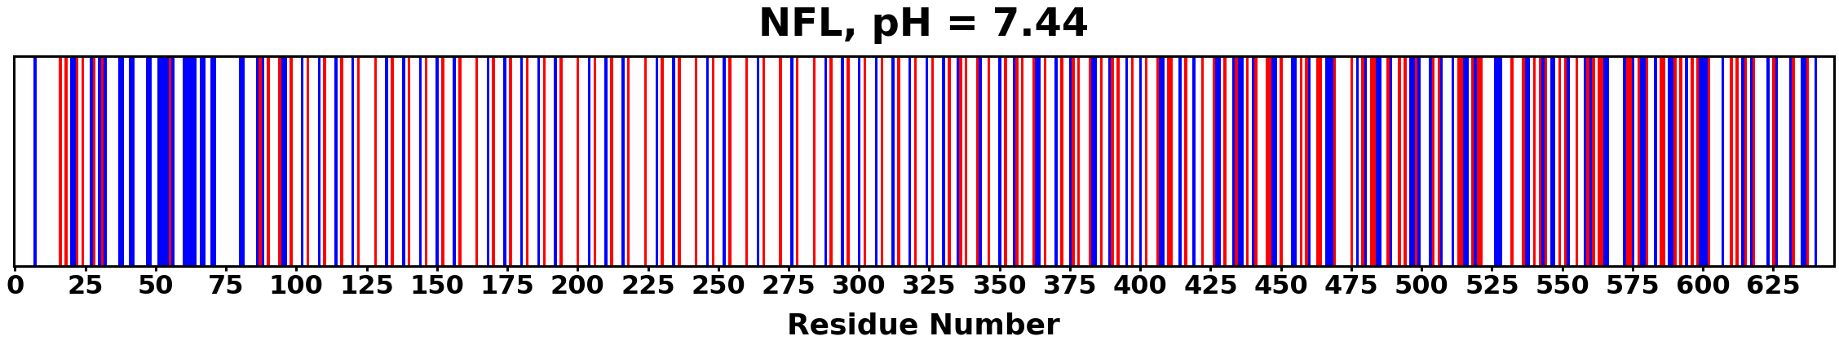
Protein Charge Distribution
Amino acid
Algorithm overview
Charge (at given pH)
Block assignment
> 0e
NFL, pH 7.44
= 0e
< 0e
> 0e
NFH, pH 7.44
= 0e
< 0e

Slide 4
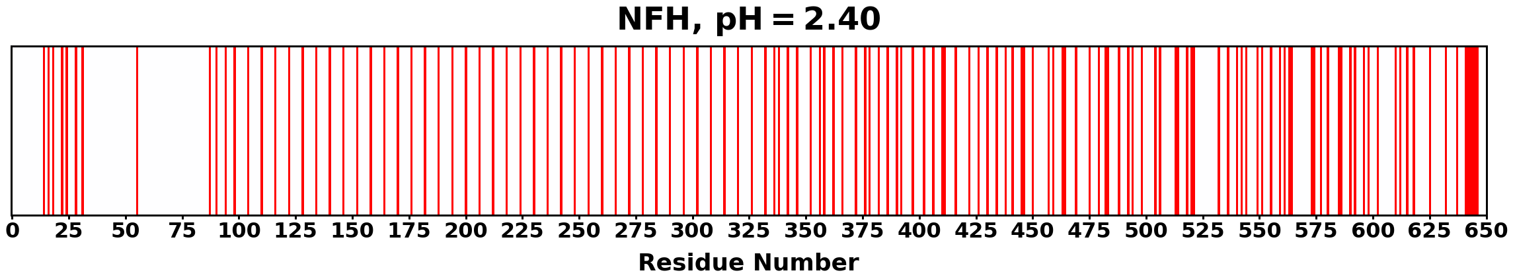
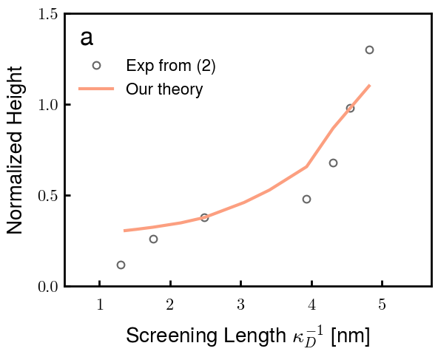
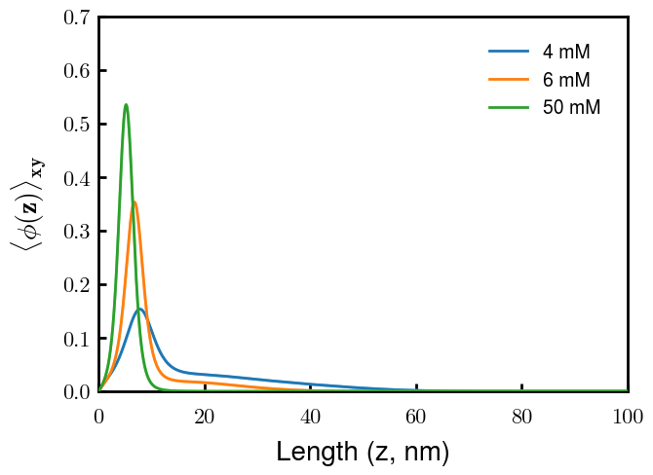
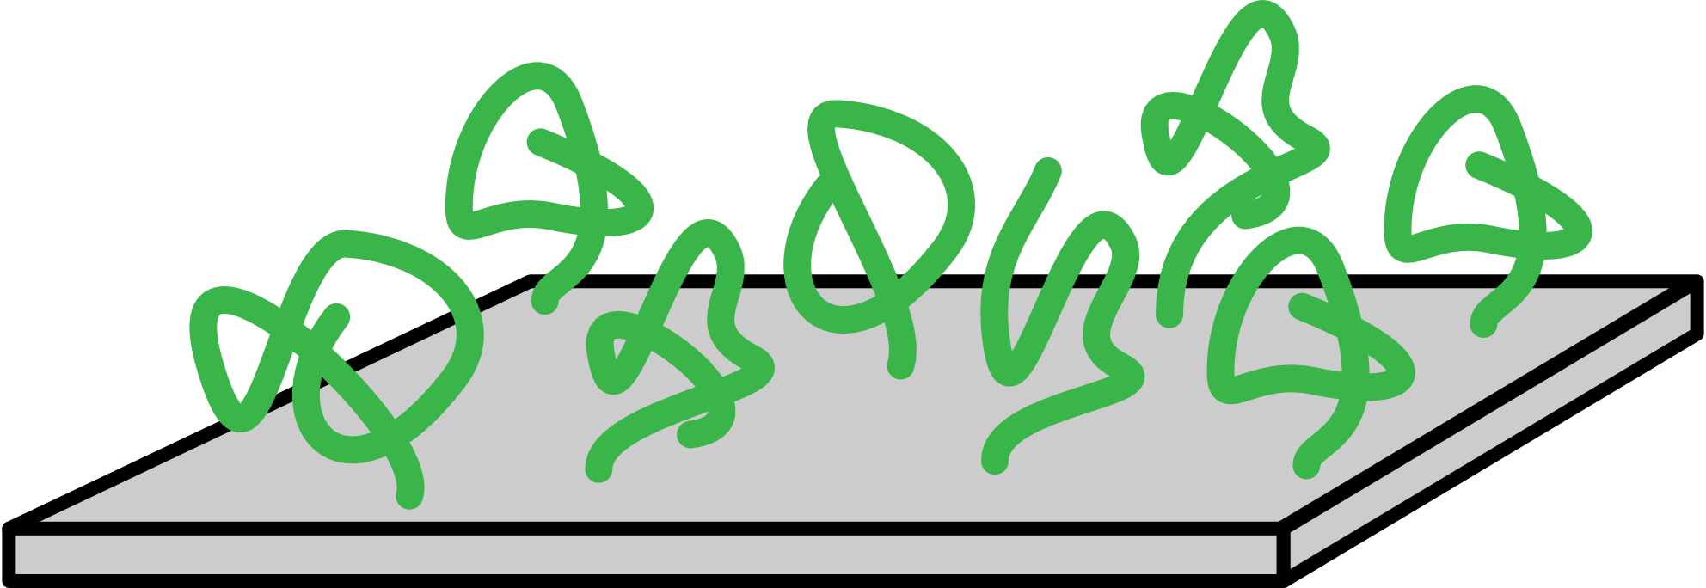
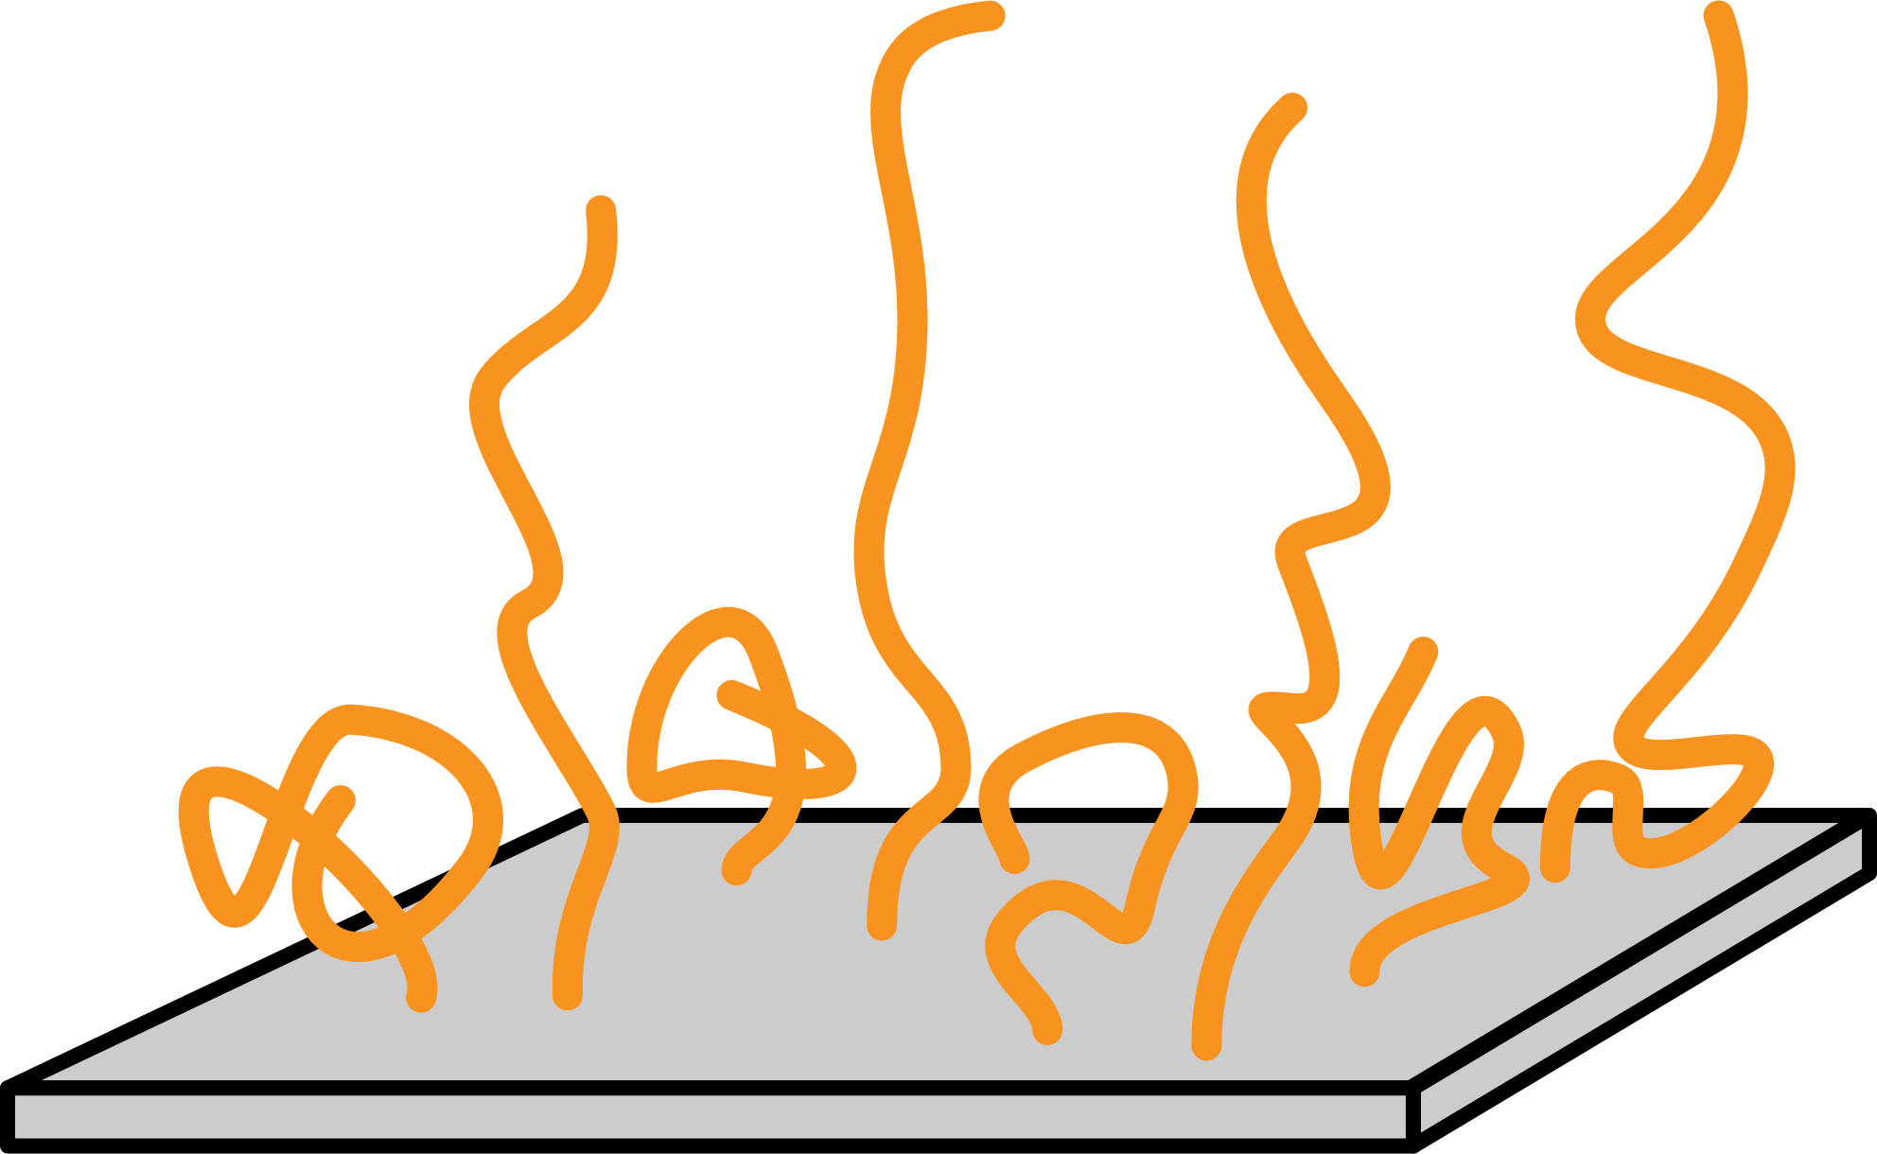
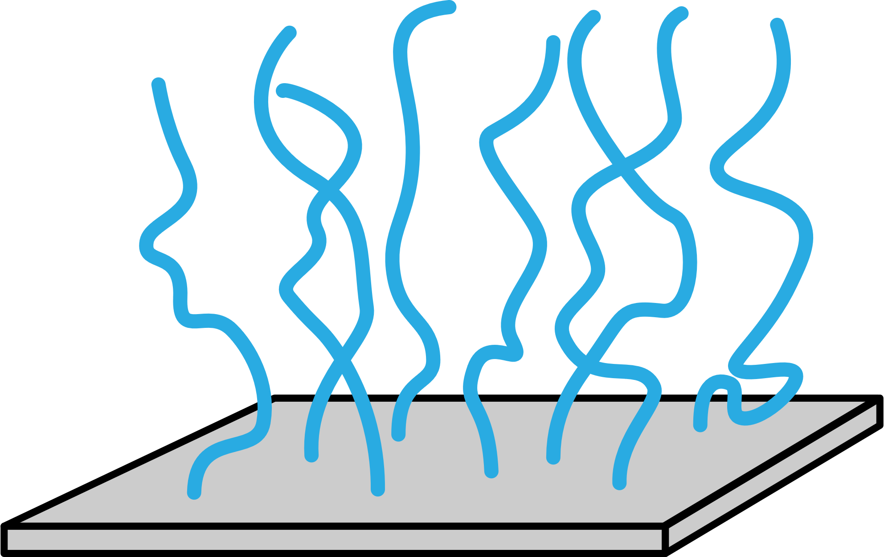
Summary of Model Capabilities (Srinivasan 2014)

Slide 5
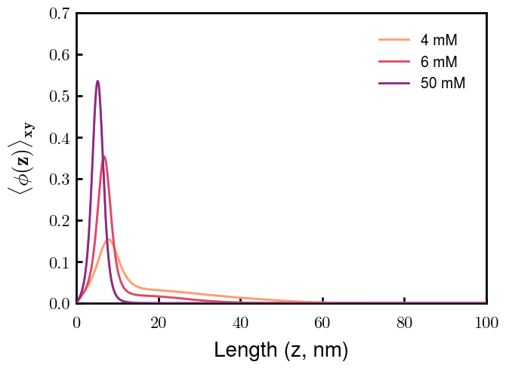
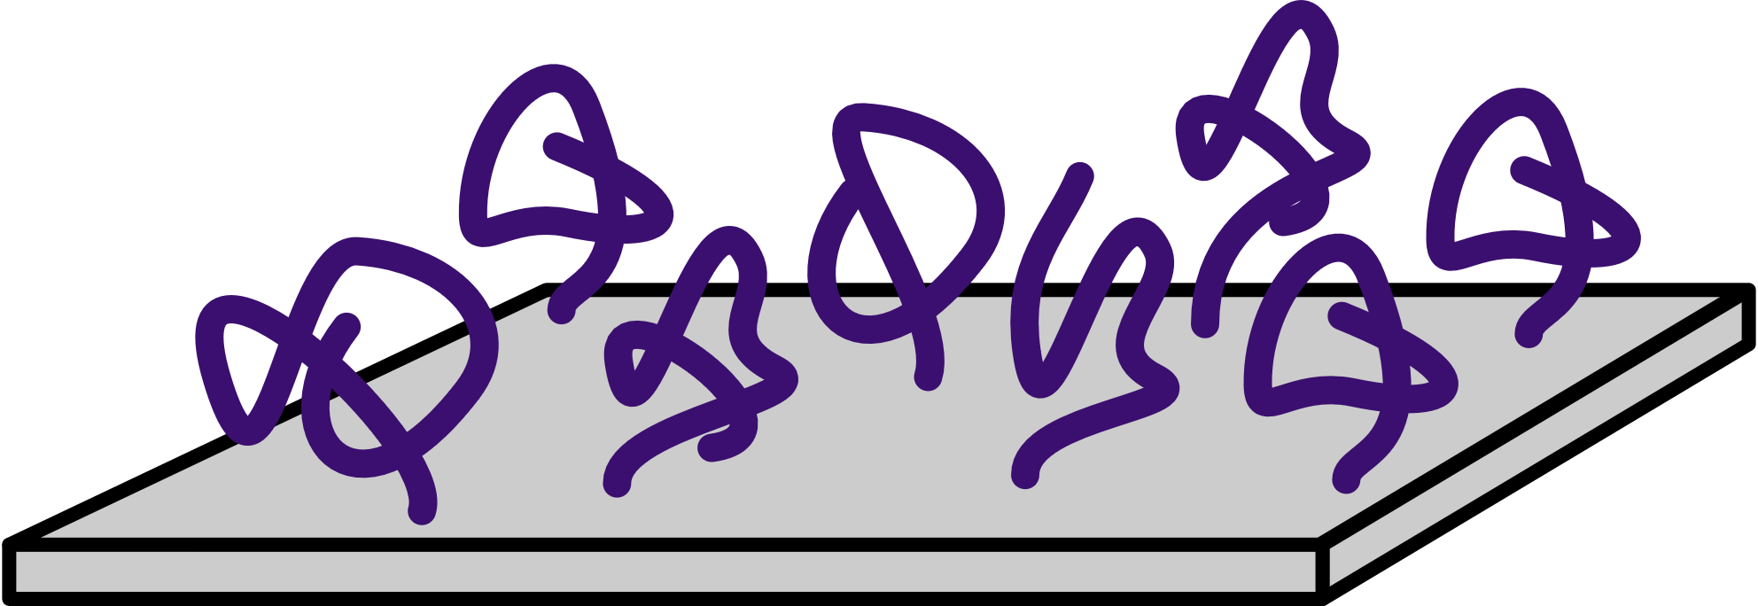
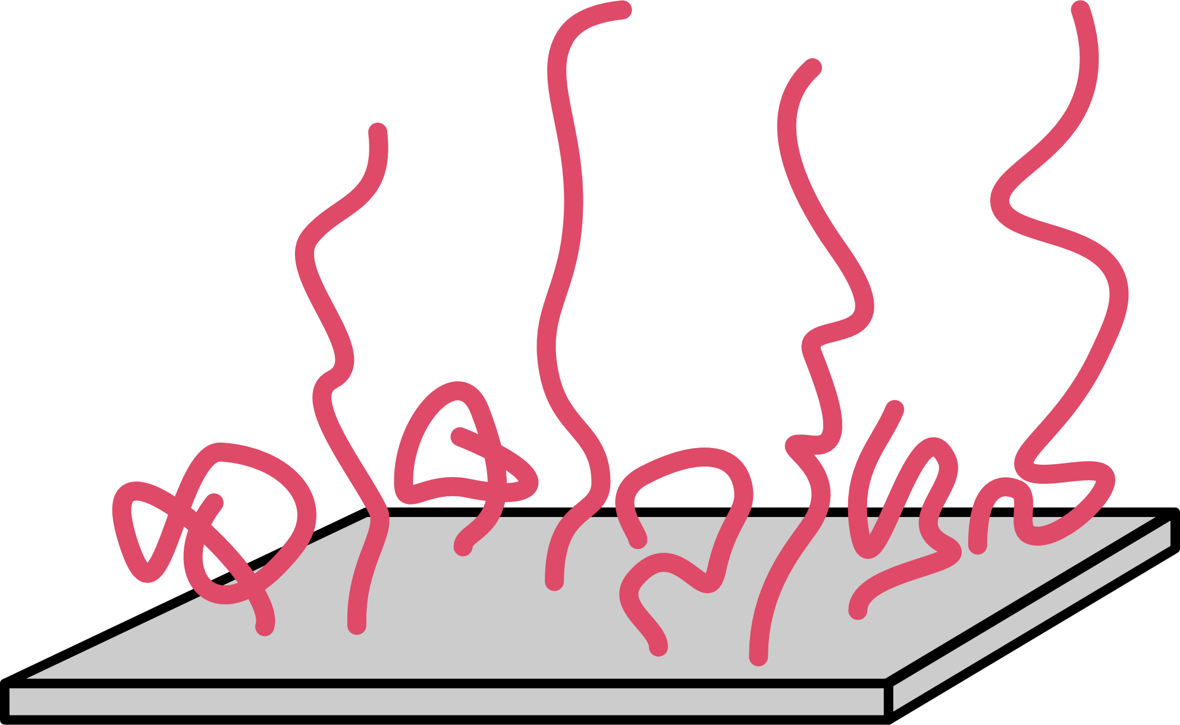
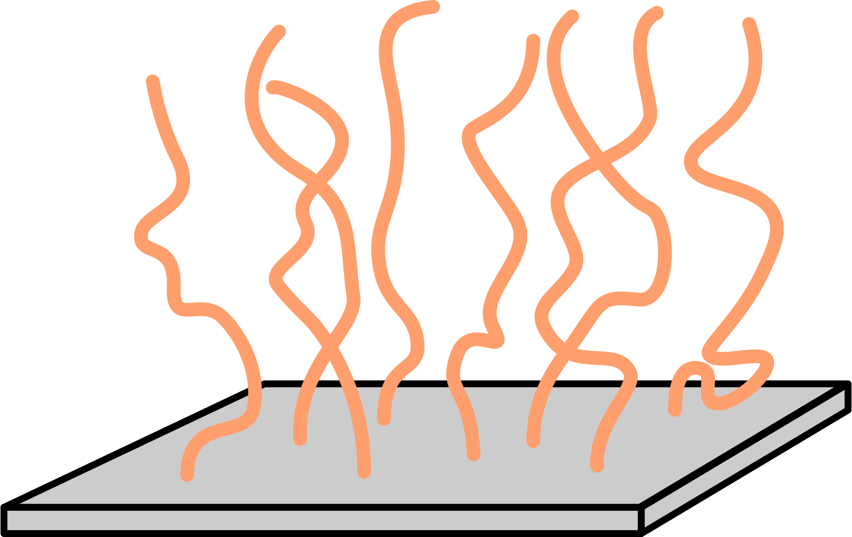

Slide 6
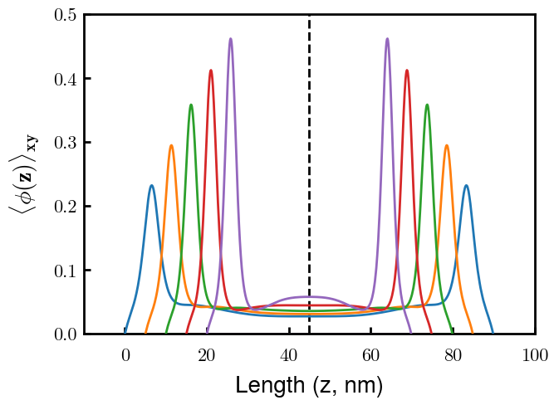
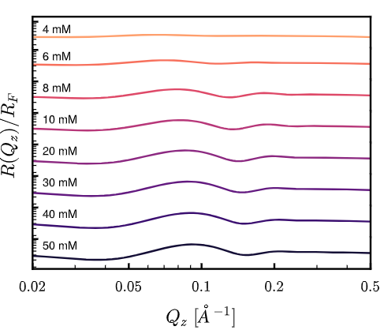
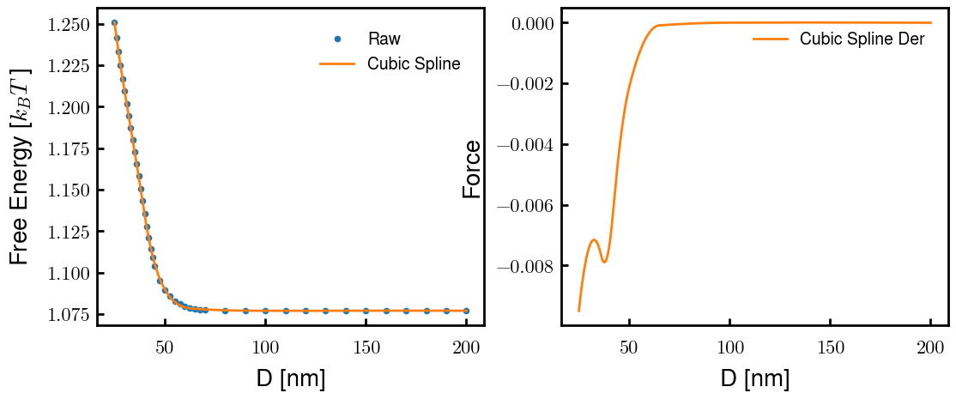
Characterization
Interacting Brushes (4 mM)
Reflectivity Spectra
Emergence of inner condensed phase

Slide 7
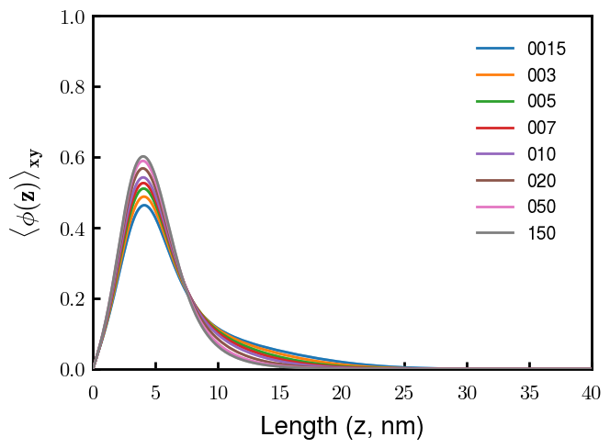
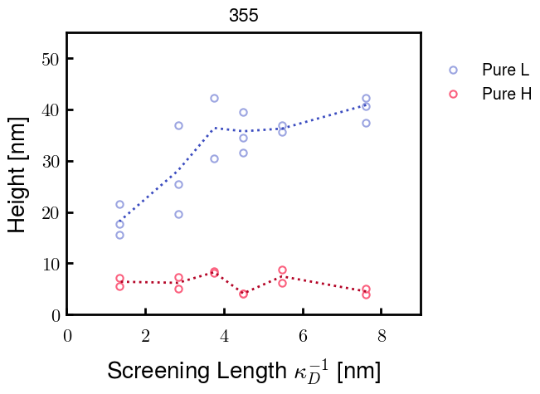
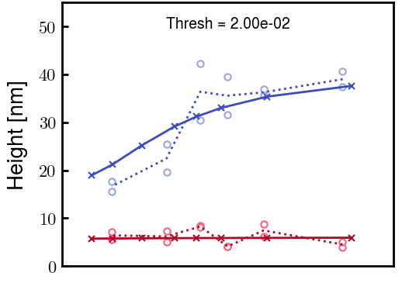
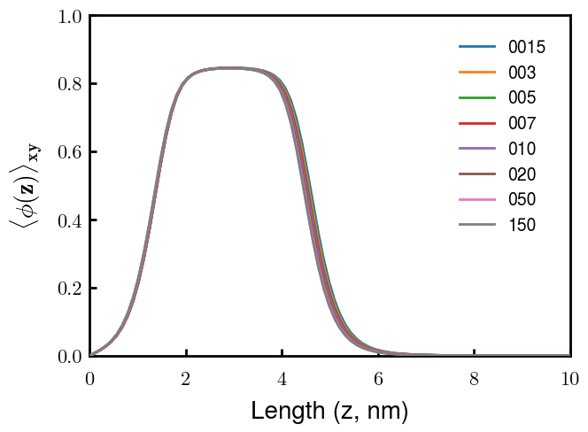
Fitting pure NFL and NFH
Experimental Data from Erika
Calculated Heights from SCFT
NFL
NFL
NFH
NFH

Slide 8
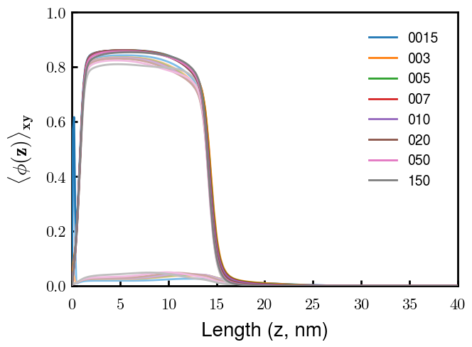
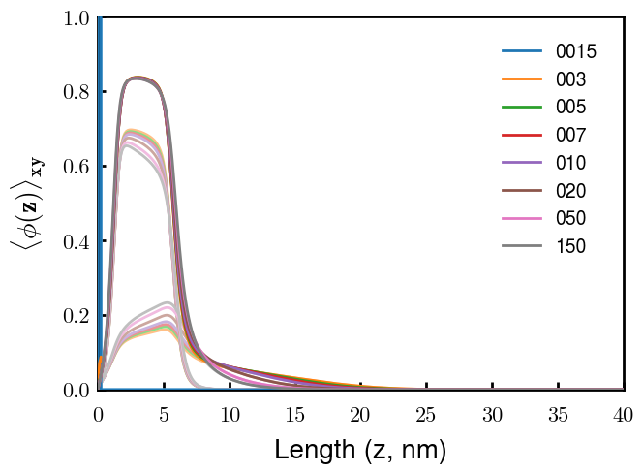
Mixture of NFL and NFH (by mole fraction)
30% L
80% L
Overall
Overall
NFH
NFH
NFL
NFL
(Preliminary results)

Slide 9
Next Steps
Fine tuning of parameters for best fit with height profiles of L-H brush
Role of charge distribution of NFH at biological pH
Charge of heterogeneous negative block of NFH (blocks 2 & 3)
L-H brushes after phosphorylation
L-M brushes (once experiments are finished)

Slide 10


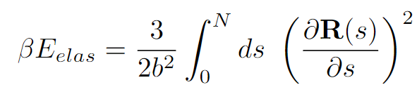
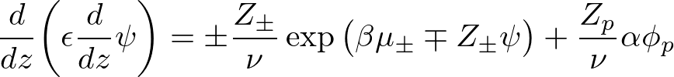
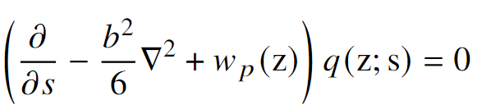
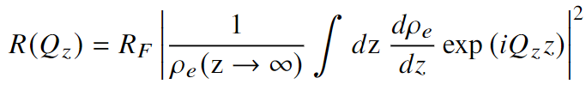
Equations

